Slide 1
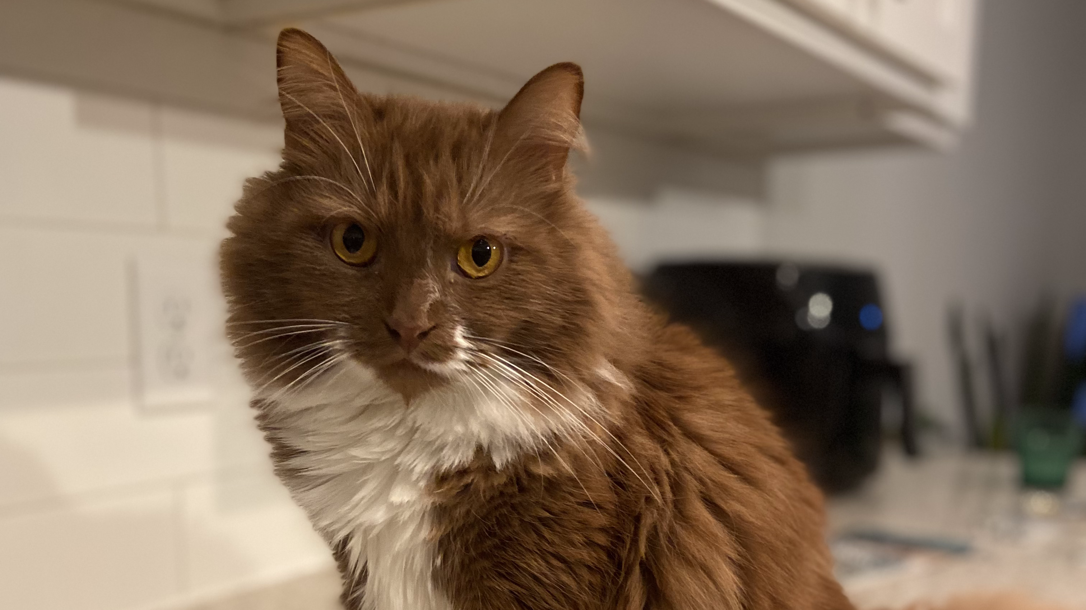

Cat Dashboard

Slide 2
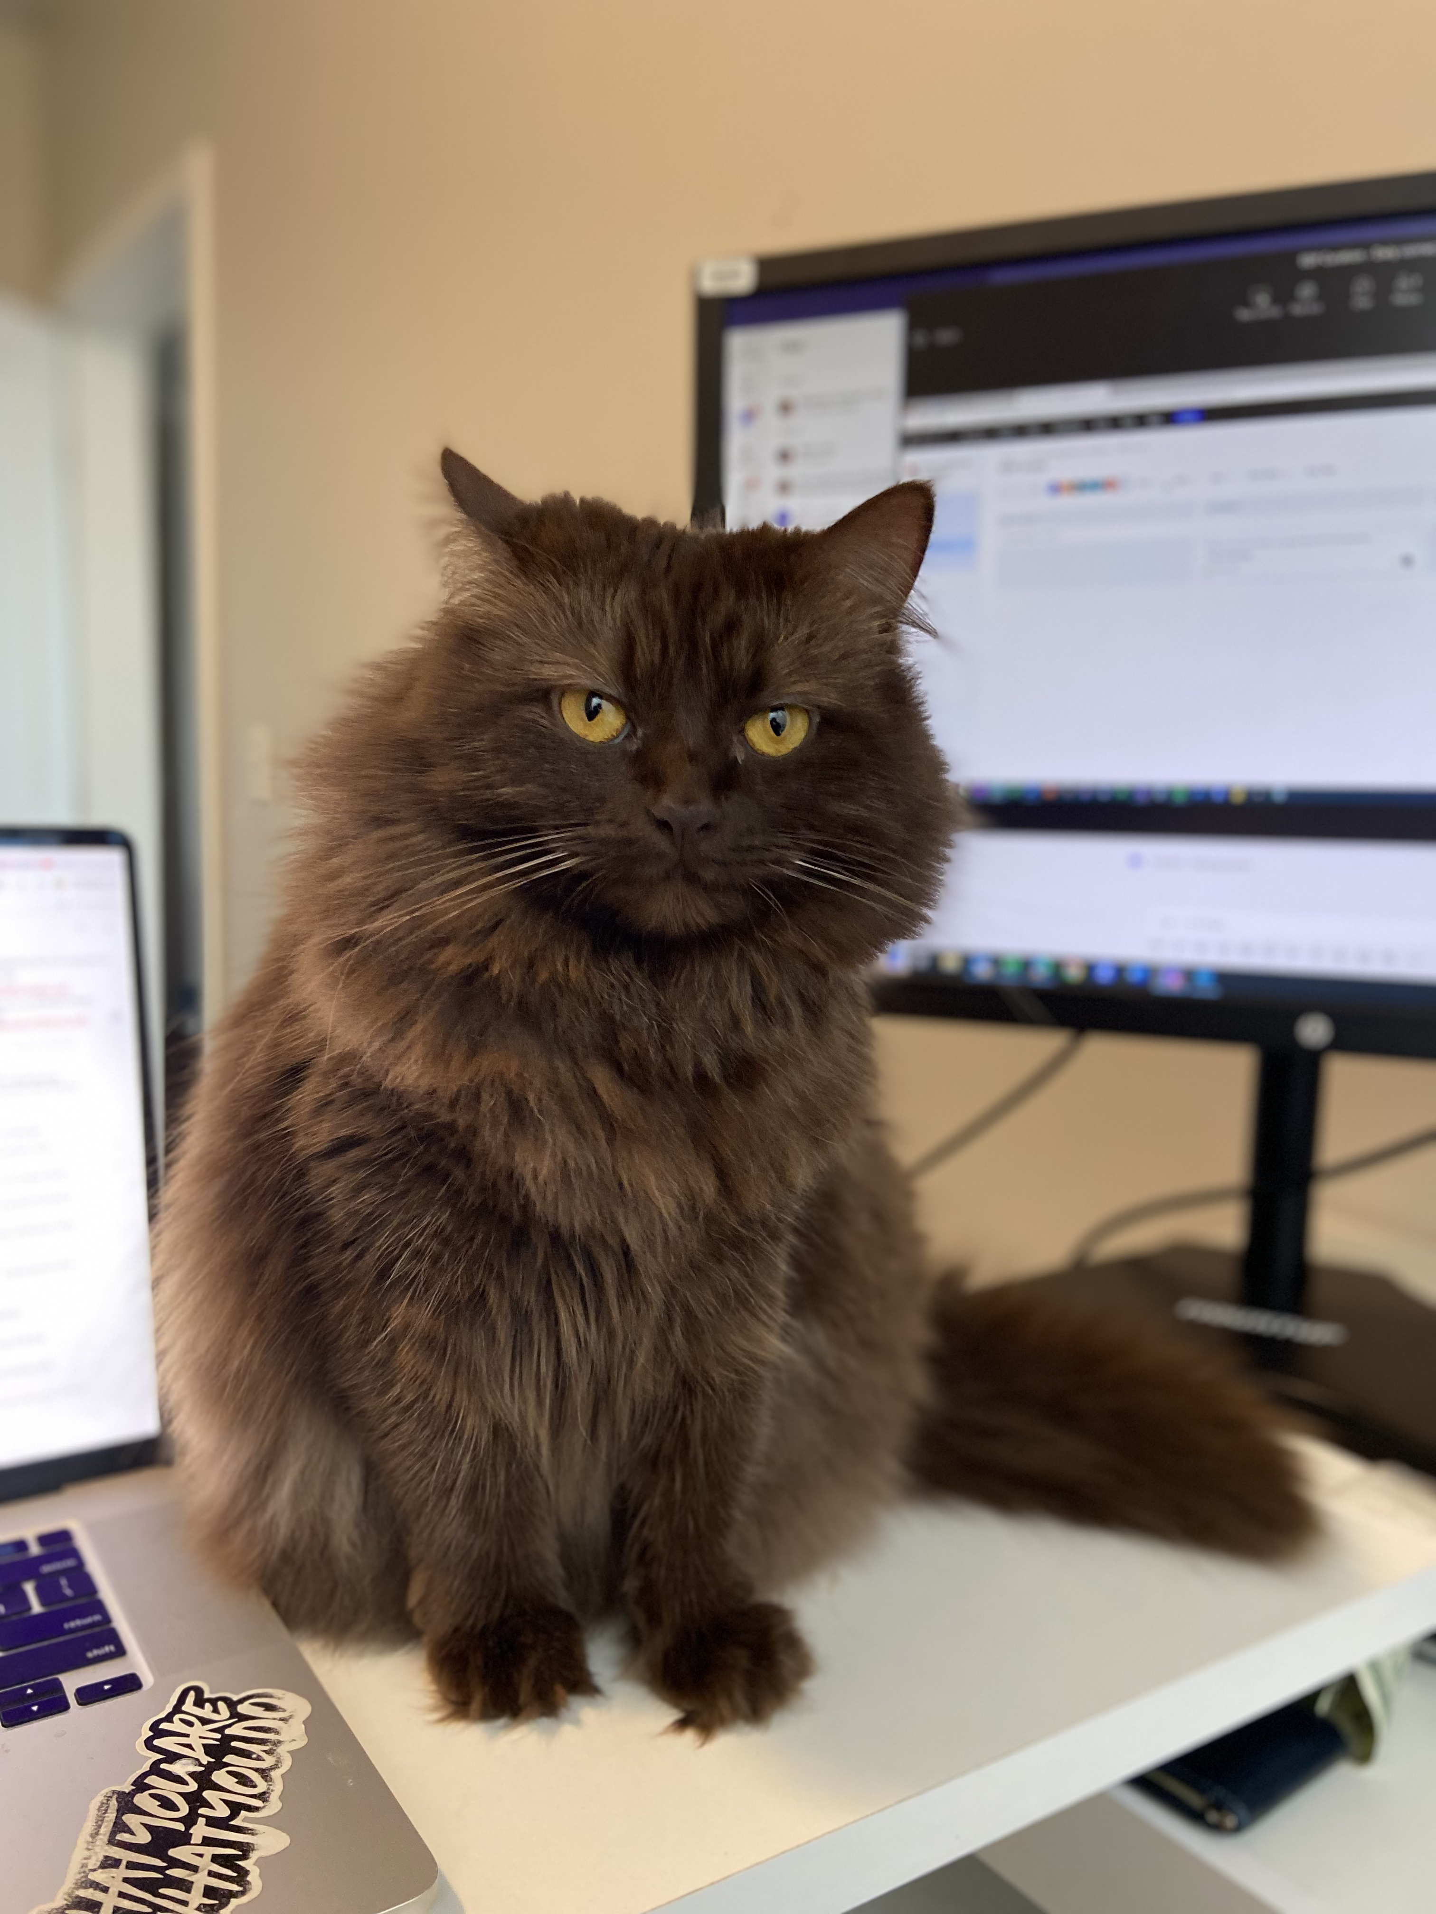
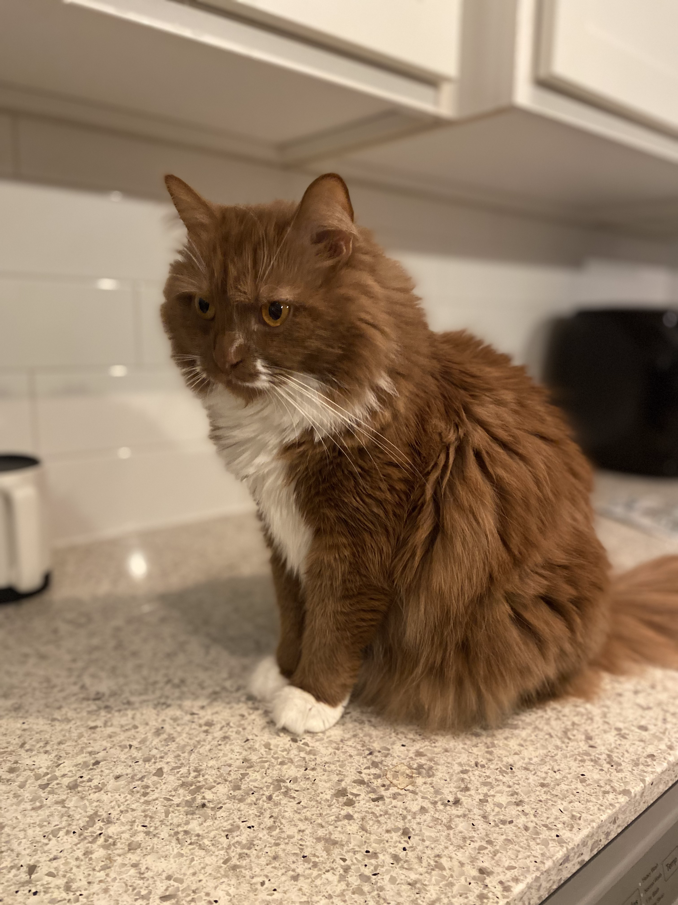

Slide 3
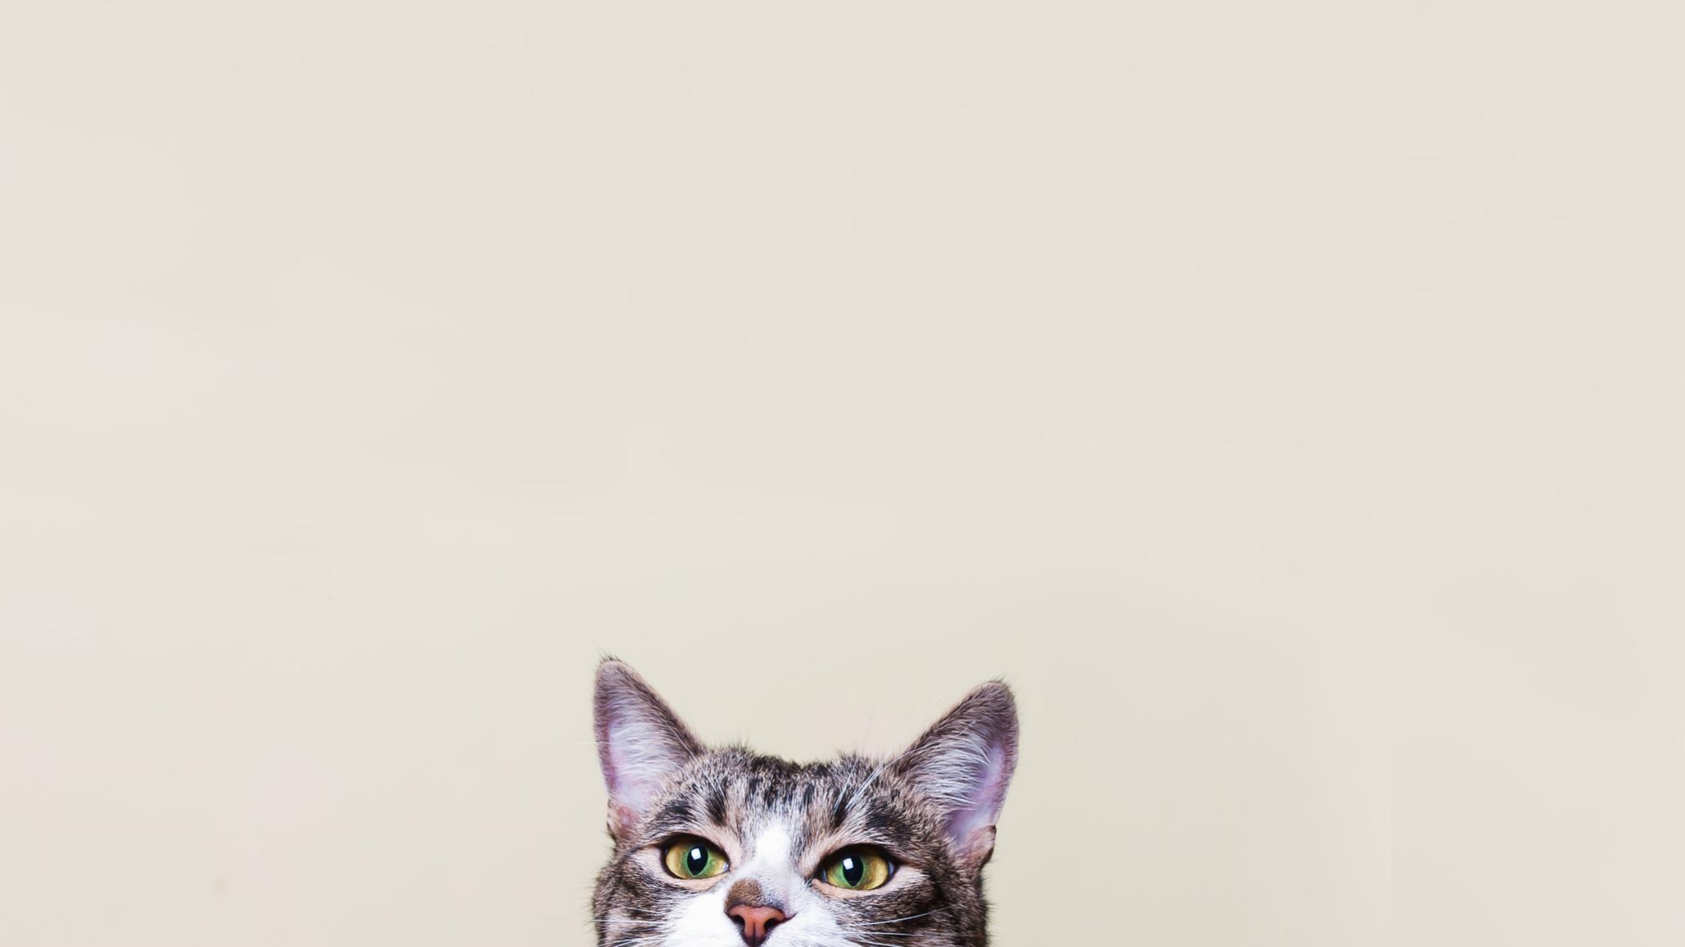
insights needed
Cat feeding schedule
A way to tell which cat fed at what time
Track feeding habits
Possibility of catching anomalies

Slide 4

Data collection
Arduino Nano BLE Sense 33
Arduino camera
Arduino IDE
Edge Impulse trained ML model

Slide 5
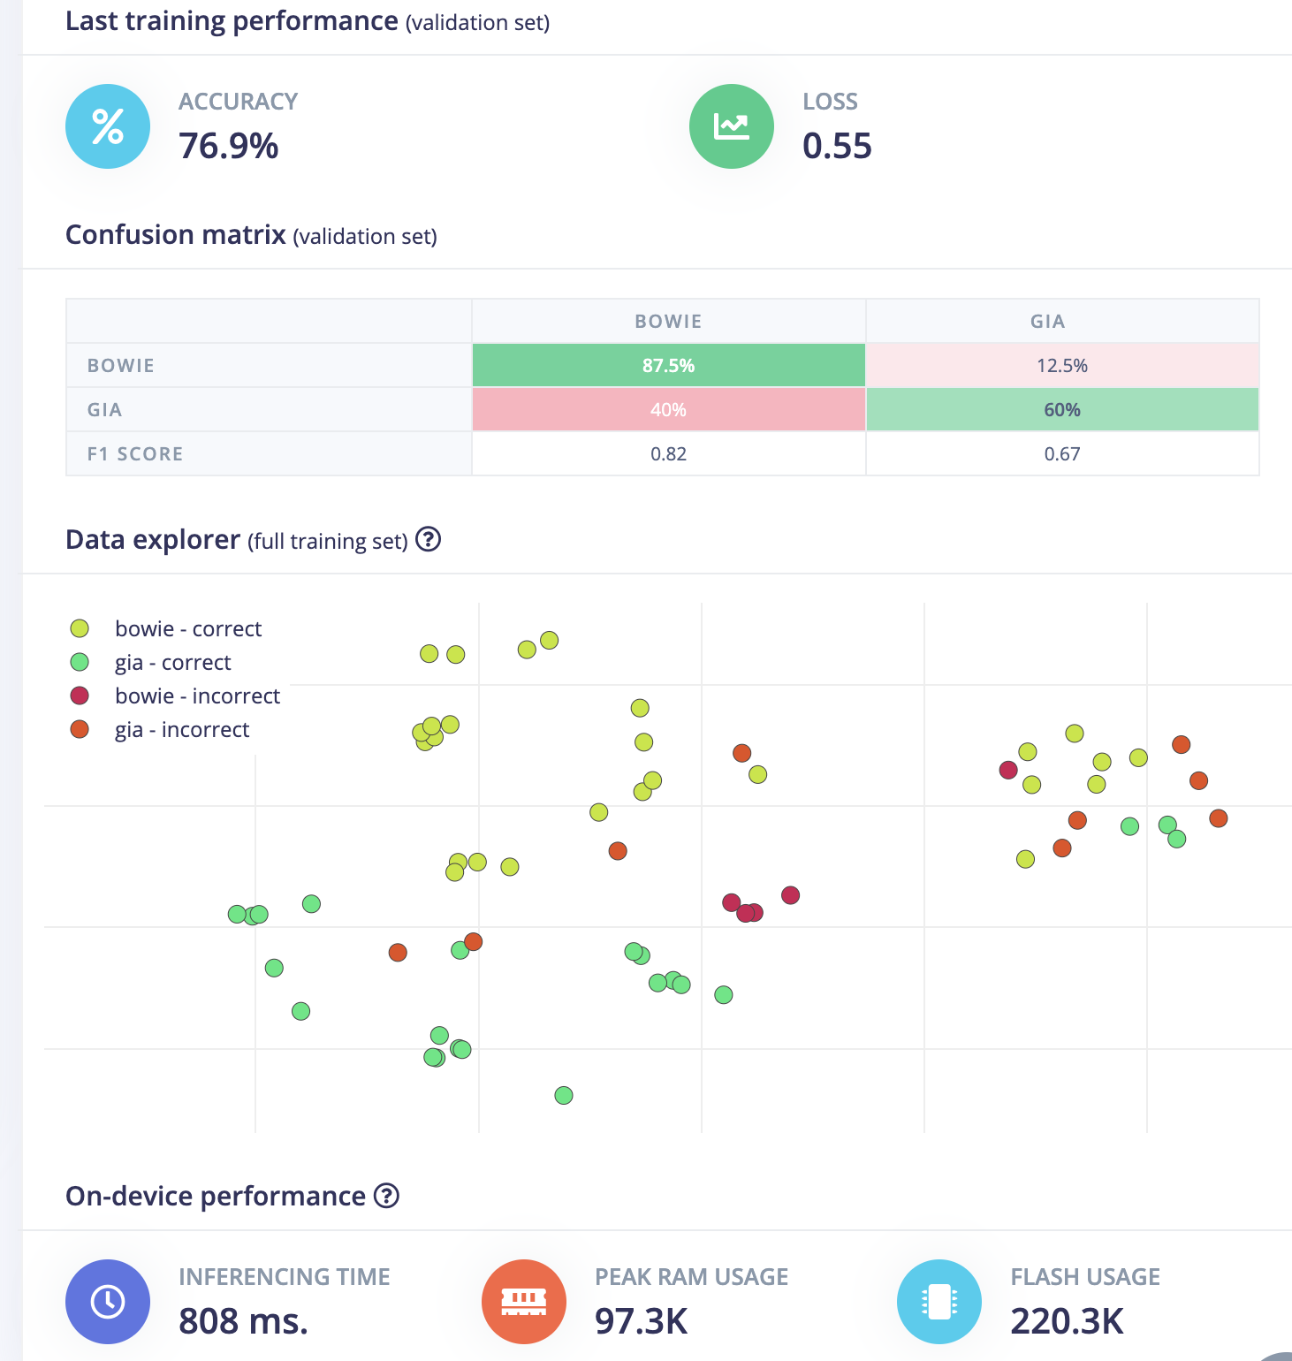
Validation

Slide 6
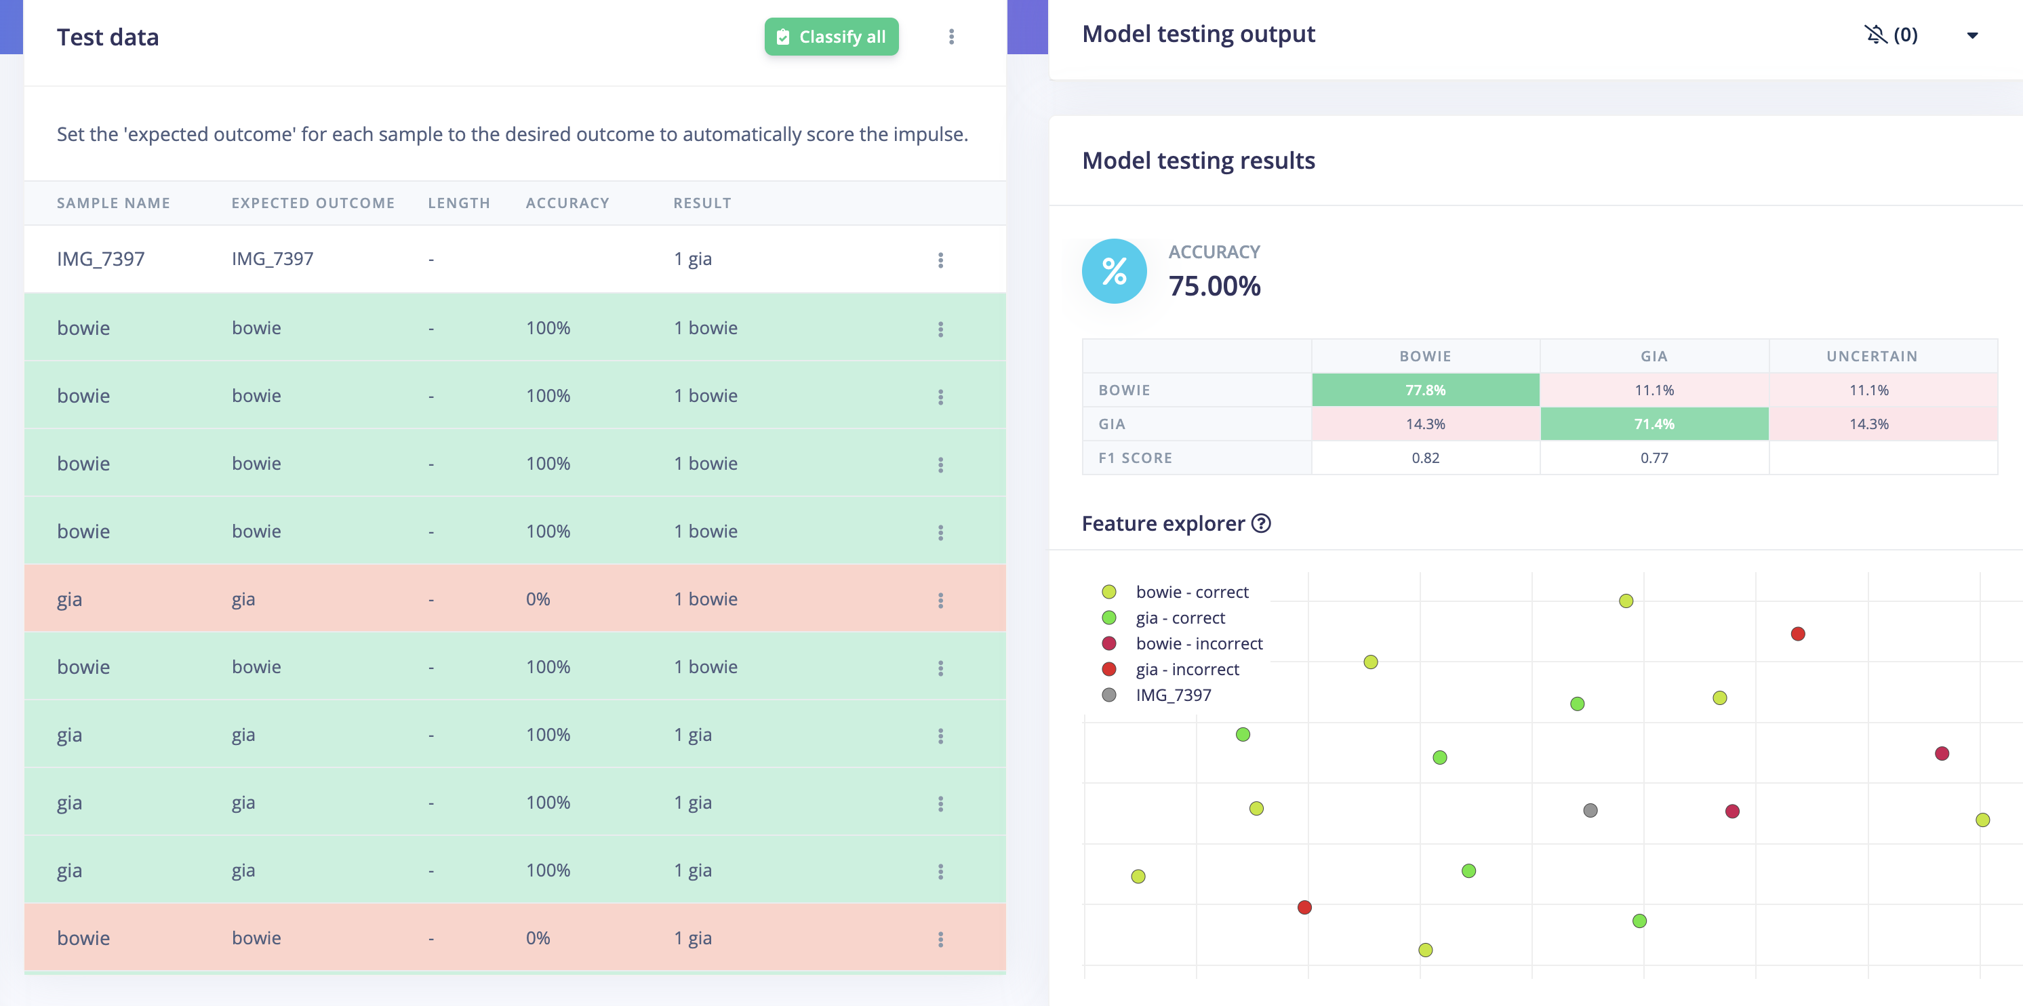
testing

Slide 7
Live inference Output:
gia: 0.72
bowie: 0.28

Slide 8

Data Ingestion
Excel data streamer?
More research needed

Slide 9

Visualization
Python libraries: matplotlib and seaborn
Streamlit app

Slide 10
Next Steps
Get a battery pack
Find a way to get data into a csv file
Figure device ‘housing’

Slide 11
Challenges
Hard to find software that works with Macbook OS for data streaming
Camera quality not great, poor inference results
Night time data will not be good

